Slide 1
IPFS

Slide 2
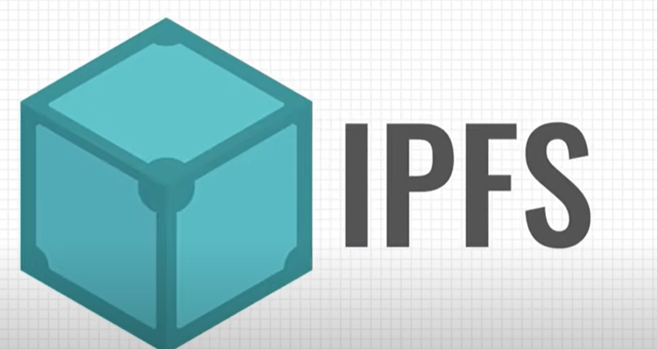
Inter
Planetary
File
System

Slide 3
Agenda
01
What Is IPFS?
02
How To Use IPFS?
03
How IPFS does this work?
04
Flow of IPFS
05
DEMO On Web3 Storage with IPFS

Slide 4


Slide 5
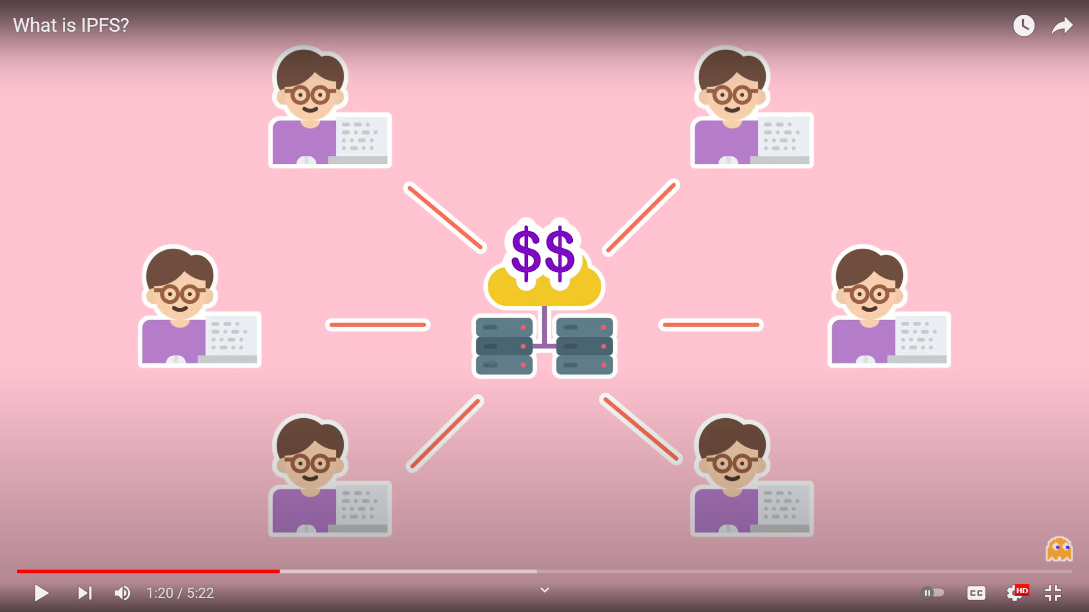
IPFS is a peer-to-peer hypermedia protocol to make the web faster, safer, and more open. In addition, IPFS will use Filecoin as a reward mechanism.
5

Slide 6

IPFS is a peer-to-peer hypermedia protocol to make the web faster, safer, and more open. In addition, IPFS will use Filecoin as a reward mechanism.

Slide 7
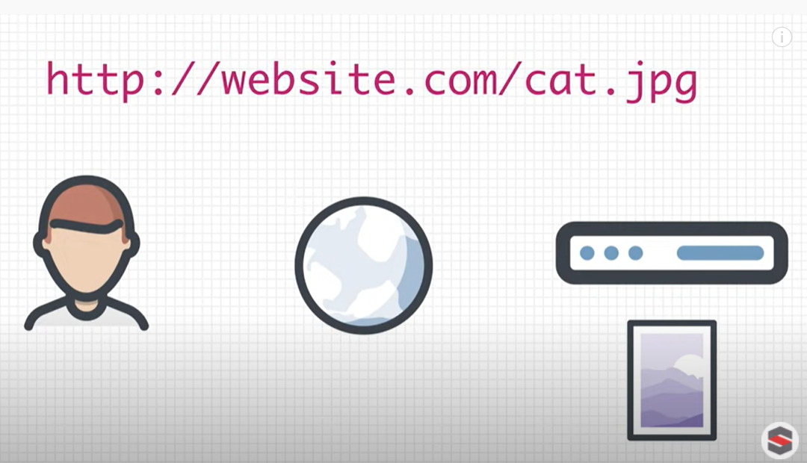
How To Use IPFS

Slide 8
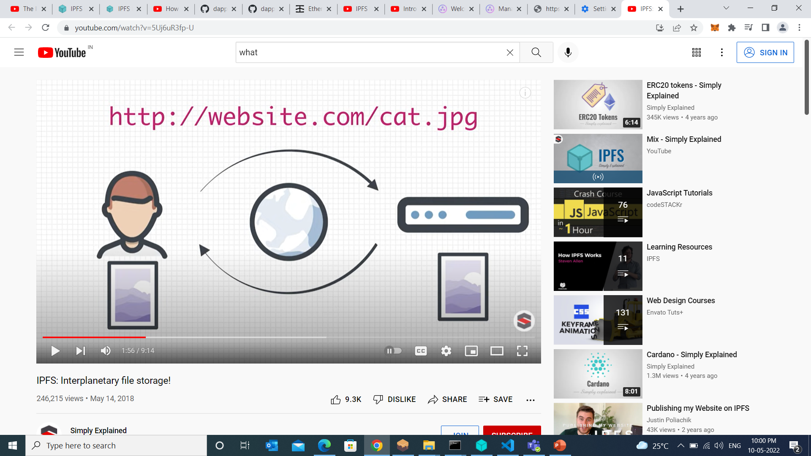

Slide 9
“Location Based address”

Slide 10
Content
“Location Based address”

Slide 11
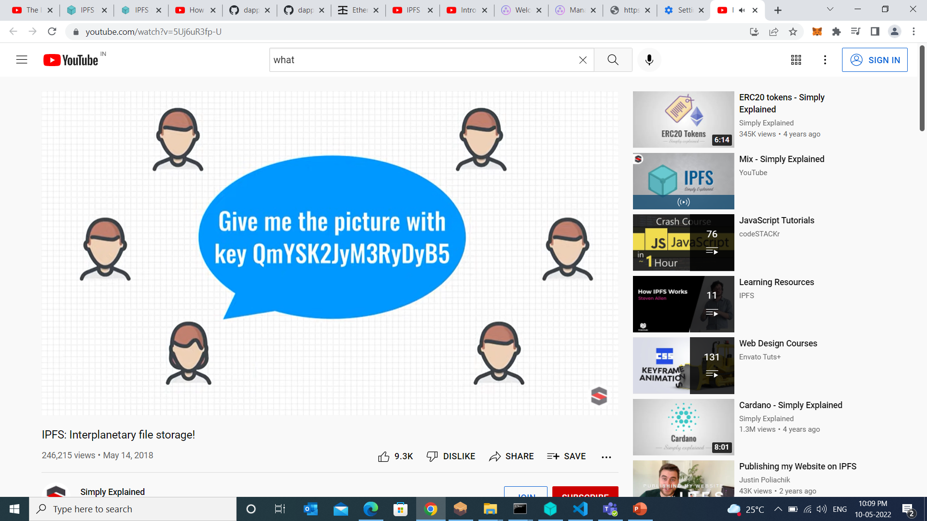
How IPFS Does The Work

Slide 12


Slide 13
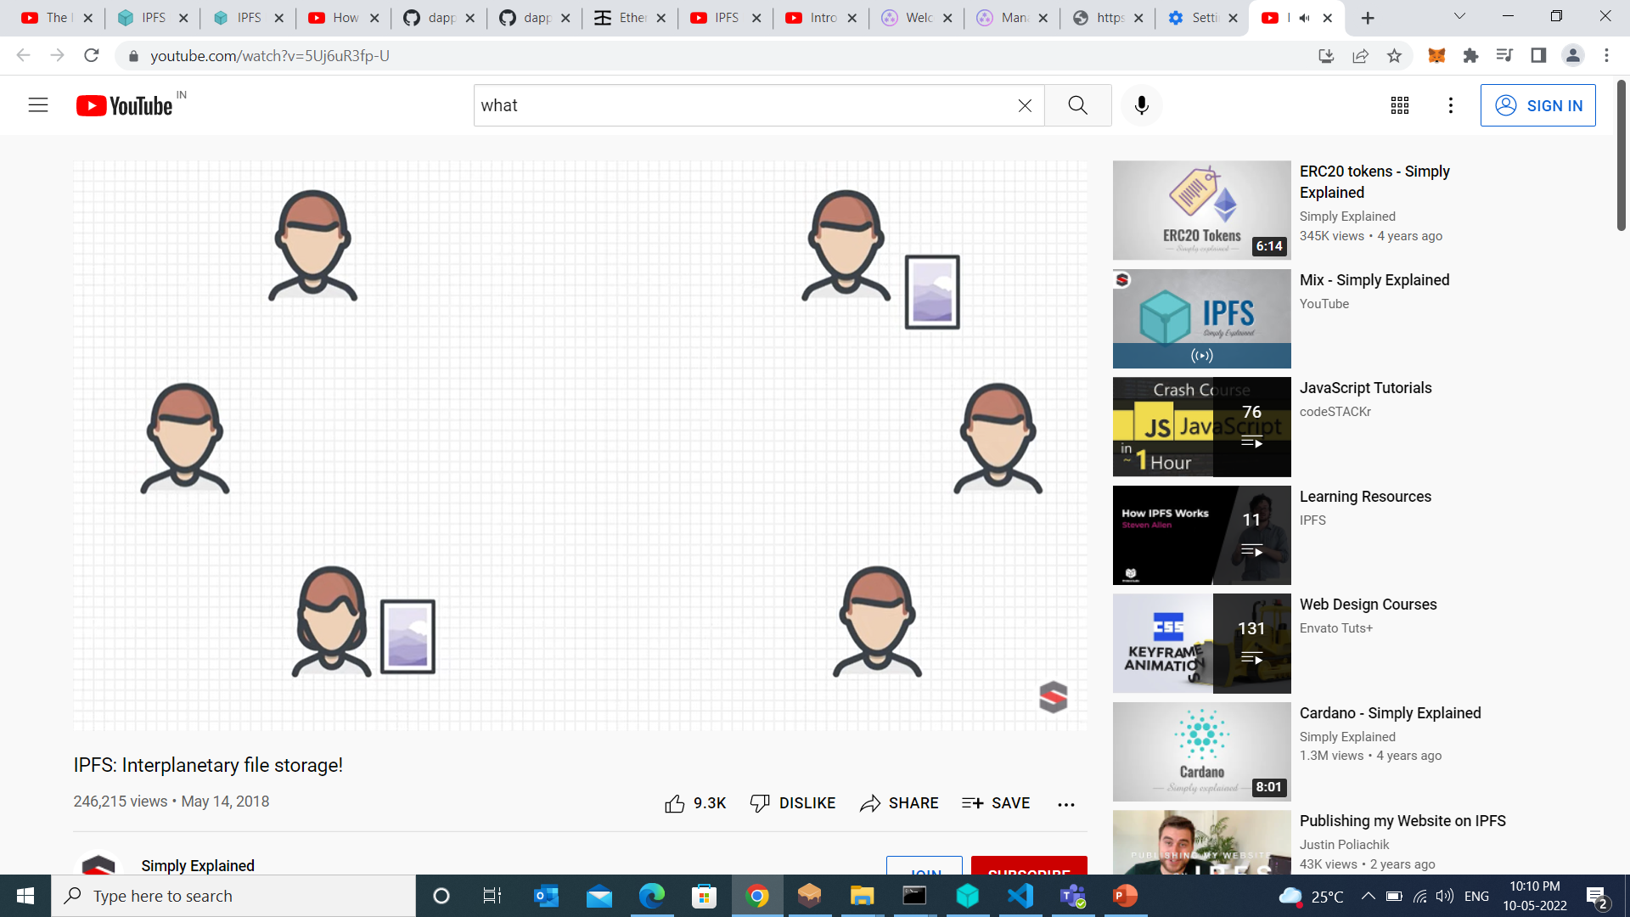

Slide 14
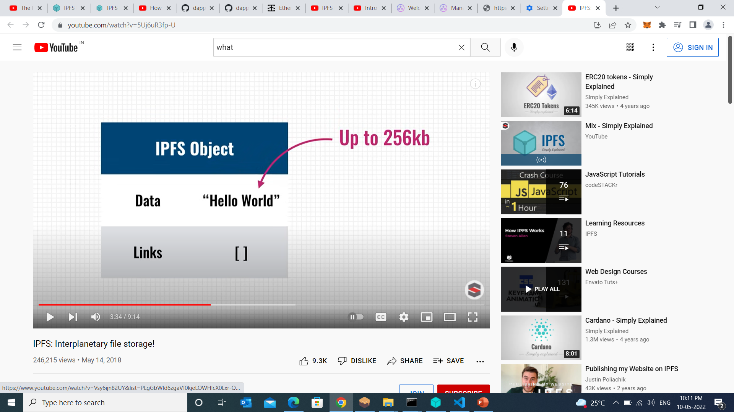

Slide 15
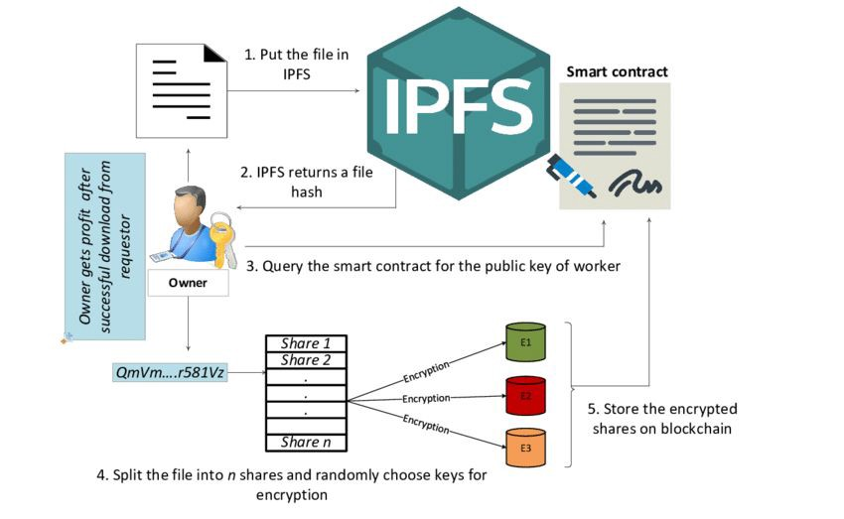
Flow OF IPFS WORK

